Slide 1
Conferences through Big Blue Button
Disclaimer:
These is just the little bit I have learned about using “Conferences” through Canvas. I’m sure there are many capabilities I am unaware of.
Also, I only tested this out at a time where, presumably, there was not heavy online traffic and I only had one conference “attendee” – not sure how smooth it will be with an entire class when a large portion of the MU population may be trying to work through the same program – you may want to have a trial run.

Slide 2
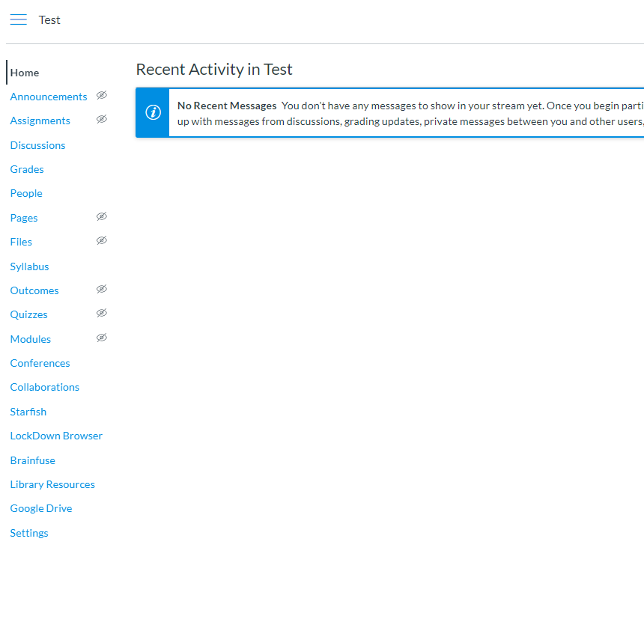
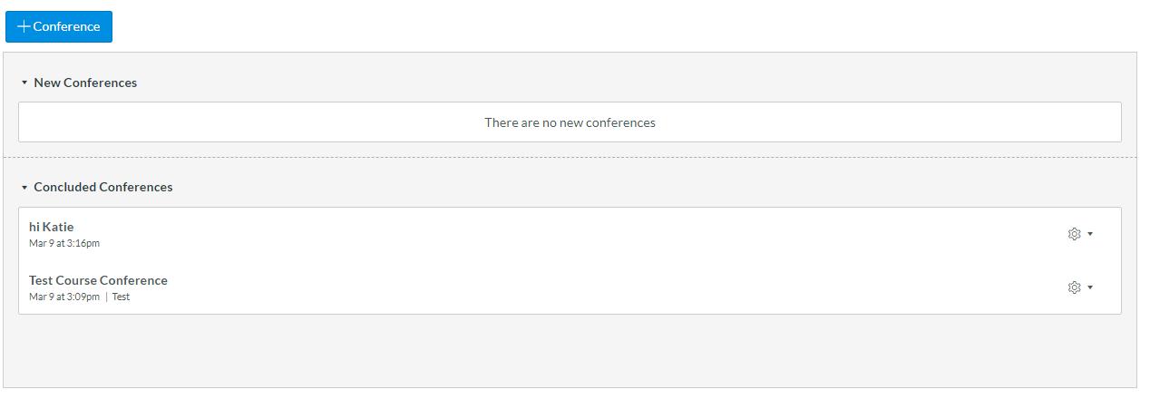

Slide 3
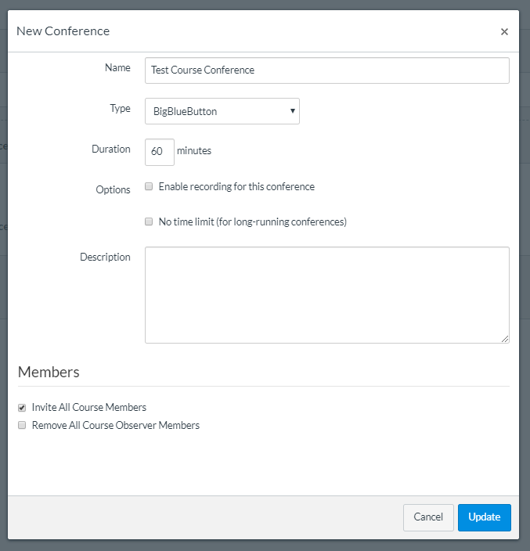
Set duration

Slide 4
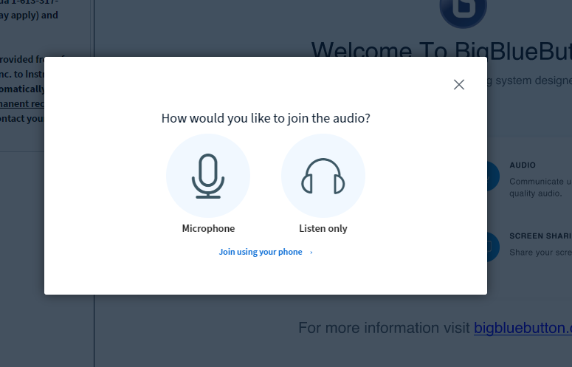
Select your preference.

Slide 5
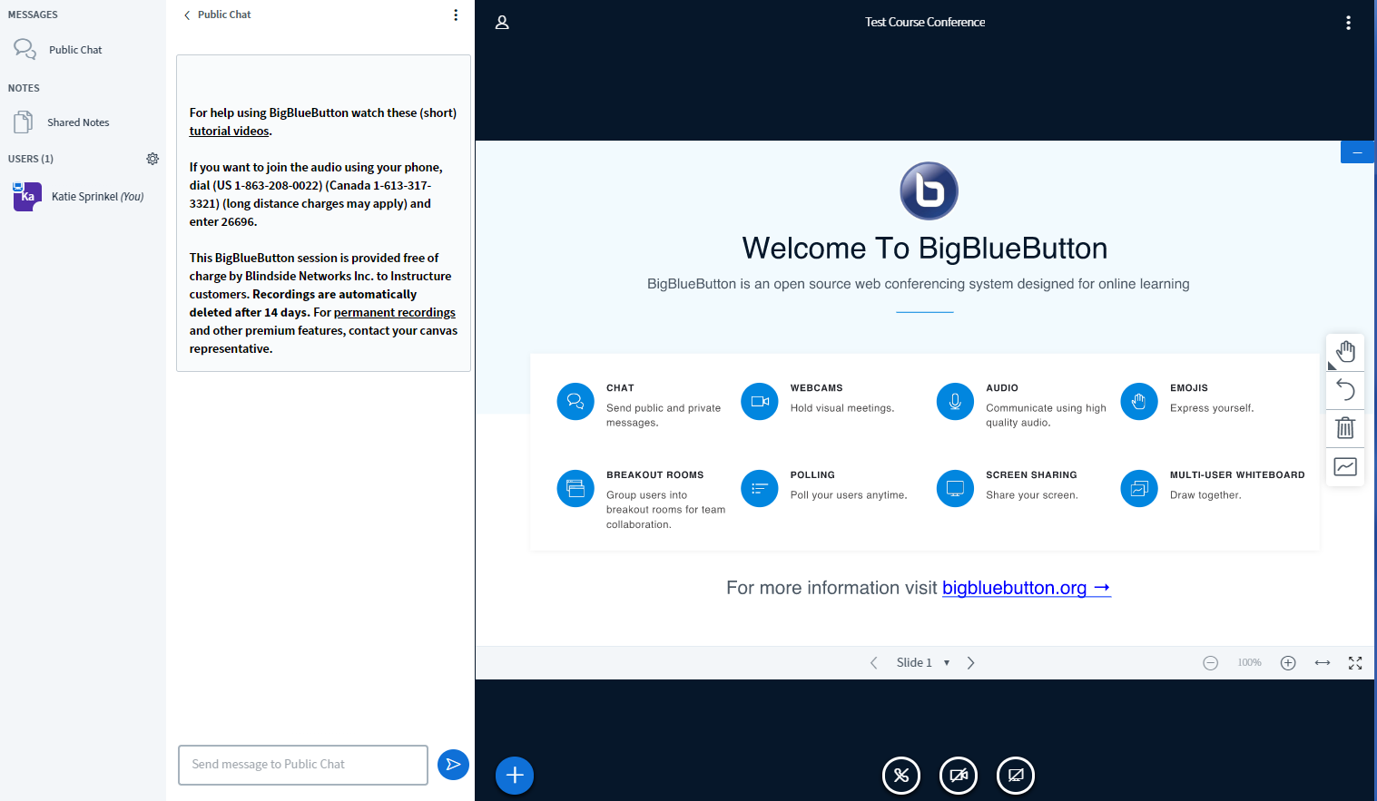
Full computer screen share
Allows annotation on slides or “white board”
Multi-use white board
Advance slides & toggle between slides and white board
Live group chat

Slide 6
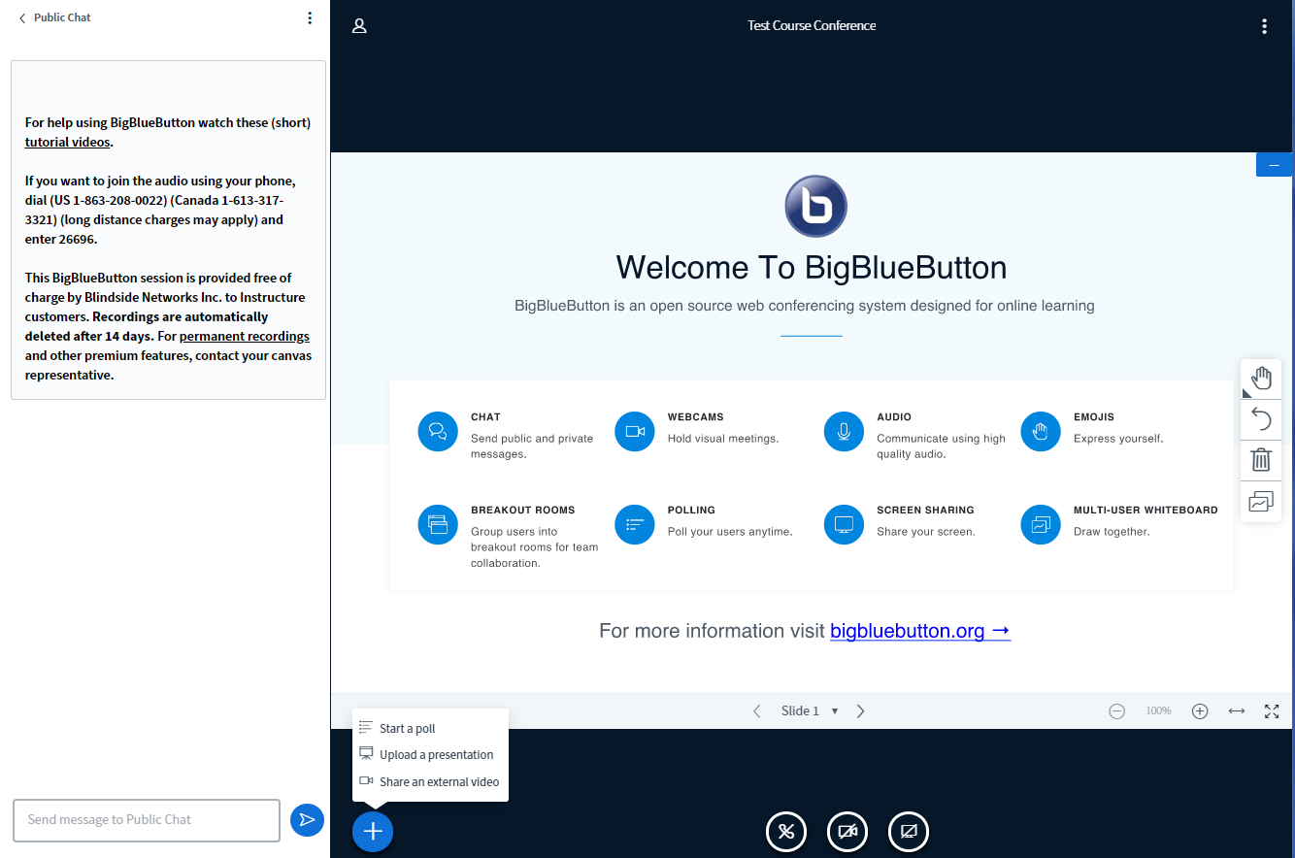

Slide 7
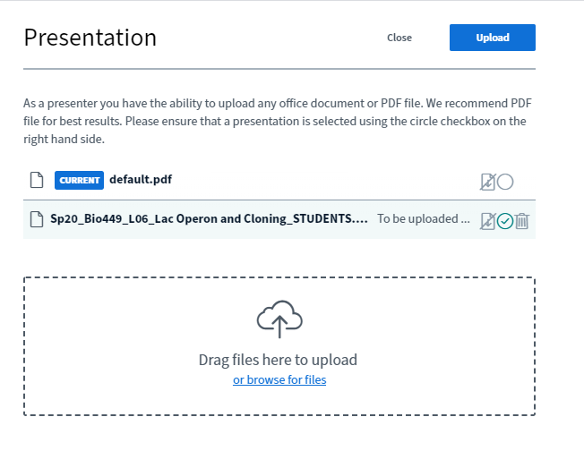
2. Upload it.
1. Find your file.

Slide 9
I can also select the draw feature and get creative!

Slide 10
Multi user “whiteboard” can be turned on or off.
I don’t know how to see blank screens once you have the presentation uploaded, but you can just use a blank slide, if necessary.

Slide 11
Options, including “End meeting”

